Slide 1



Penetration test GNX E600 Pure
Lyubomir Georgiev, Hristo Kolev, Yoan-Asen Popov, Joep Vinken
Notes:
Lyubo

Slide 2

Table of contents
01
02
03
04
05
Overview of the project
Methods and Tools
Test
Results
Project Scope and Objectives
Techniques and Resources Utilized
Outcomes of the Penetration Testing
Recomendations
Conclusion
Proposing Security Enhancements
Final Observations and Future Steps
Notes:
Joep

Slide 3
01
Project Overview
Project Scope and Objectives
Notes:
Joep

Slide 4

About the topic
Project Synopsis:
Our mission is to conduct a detailed and thorough penetration test on the Genexis E600 Pure router.
The Subject:
Our focus: The Genexis E600 Pure router
Key Features: Capable of supporting up to 5400 Mbps network, two versions with either Wi-Fi 5 or Wi-Fi 6.
Uncovering Weaknesses:
We are set to examine the router's operation in-depth, scrutinizing all levels to spot potential vulnerabilities.
Assisting Genexis:
Our testing insights will guide Genexis in enhancing product security by offering strategic recommendations to address discovered vulnerabilities.
Notes:
Joep

Slide 5
02
Methods and Tools
Techniques and Resources Utilized
You can enter a subtitle here if you need it
Notes:
Hristo

Slide 6

Methods and Tools
Scanning:
Routersploit: An open-source exploitation framework dedicated to embedded devices.
Nmap: A free and open-source network scanner designed to discover hosts and services on a computer network.
Privilege Escalation:
Changing the Password: Manipulating user credentials to gain elevated access to resources that are normally protected from an application or user.
LAN Turtle:
A tool providing stealth remote access, network intelligence gathering, and man-in-the-middle surveillance capabilities.
Notes:
Talk about wifi hacking
Hristo

Slide 7
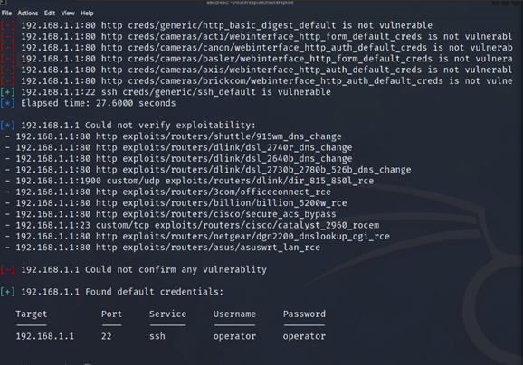
Routersploit
Utilization of Routersploit
Automation scripts - Routersploit offers various exploits tailored for different router models.
Remote vulnerability check - Tool checks target vulnerability before deploying an exploit.
Successful Test Outcomes
Access to router - Exploited system vulnerability to obtain unauthorized access.
Weak user credentials - "operator" username and password, granting root access.
Sensitive data exposure - Access to router's system data, posing a risk for data breaches.
File modification potential - Full system access allows any file to be changed.
Notes:
Gaining SSH access from the LAN side allowed us to observe that the "operator" user had root access to the system, posing a significant security risk.
With root access, any system file could be modified, and sensitive data within the router's system could be accessed, presenting a potential risk for serious data breaches if exploited by malicious actors.
Hristo

Slide 8
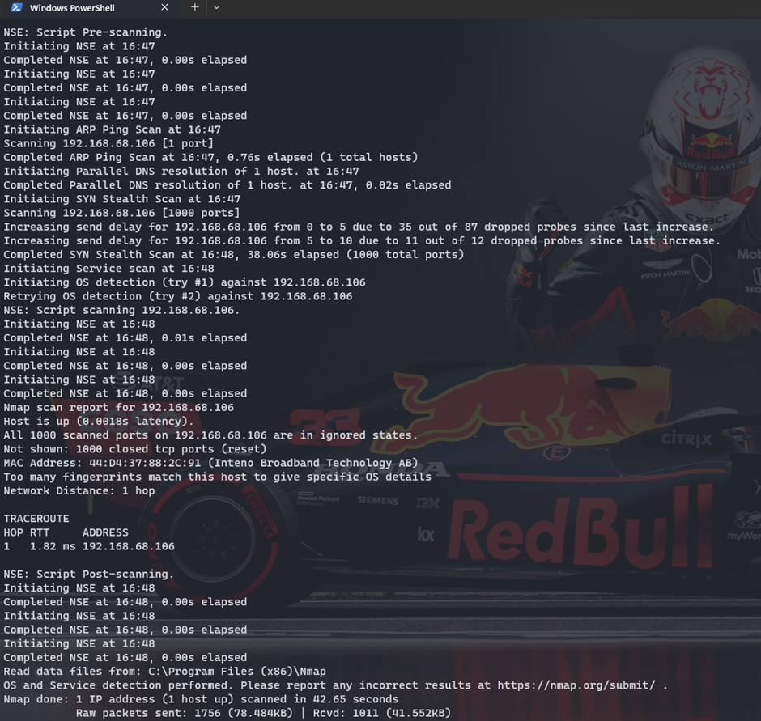
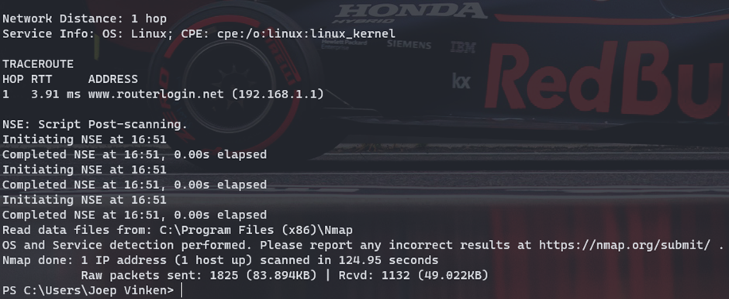
Nmap
Nmap Scanning Process
WAN Side - Nmap scan conducted on WAN side to identify potential open ports
LAN Side - Nmap scan conducted on LAN side to identify potential open ports.
Scan Results and Security Implications
No Open Ports - Indicates correct firewall configuration, reducing chances of unauthorized access from external attackers.
LAN Vulnerabilities - Despite secure WAN, LAN vulnerabilities may still be exploited by internal attackers.
nmap -T4 -A -v 192.168.1.106
nmap -T4 -A -v 192.168.1.1
Notes:
Gaining SSH access from the LAN side allowed us to observe that the "operator" user had root access to the system, posing a significant security risk.
With root access, any system file could be modified, and sensitive data within the router's system could be accessed, presenting a potential risk for serious data breaches if exploited by malicious actors.
Hristo

Slide 9
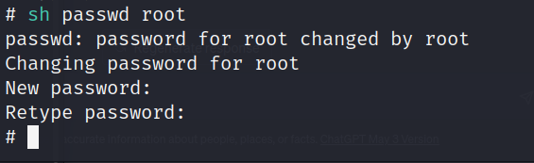
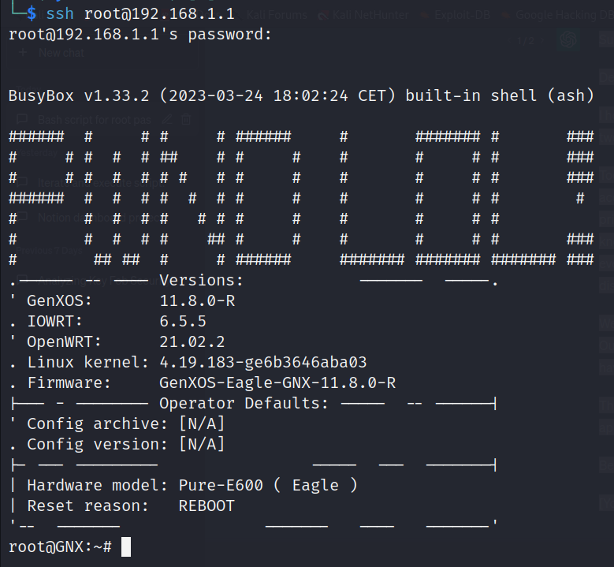
Privilege escalation
Achieving Root Access
"Operator" user privileges - Root-level system permissions grant complete control.
System modification capability - Alteration of any file or setting within the system.
Potential Damages
Full access to sensitive data - Exposes confidential information stored within the router's system, such as user credentials and network configurations.
Data breach risk - Severe data breaches due to unauthorized access and manipulation of sensitive information.
Network disruption - Attacker can modify network settings, causing service outages or reduced performance.
Notes:
Gaining SSH access from the LAN side allowed us to observe that the "operator" user had root access to the system, posing a significant security risk.
With root access, any system file could be modified, and sensitive data within the router's system could be accessed, presenting a potential risk for serious data breaches if exploited by malicious actors.
Lyubo

Slide 10
03
Test Results
Outcomes of the Penetration Test
Notes:
Lyubo

Slide 11
Test Results
Key Findings:
'Operator' Account Privileges - Uncovered using routersploit framework, the 'operator' account has sudo privileges, enabling root password modifications without prior knowledge.
Successful Access with Sudo Privileges - Allowed reading and writing of all system files.
Proof of Concept - Altered root profile's banner to display a unique message as a demonstration of access control.
Challenges Encountered:
Unable to access the router from the WAN side due to closed ports, limiting the scope of potential vulnerabilities.
Notes:
Lyubo

Slide 12
04
Recomendations
Proposing Security Enhancements
Notes:
Yoan

Slide 13
Recommendations
Strengthen Operator Password
Ensure operator account password differs from account name.
Enforce a strong password policy using mixed case letters, numbers, and special characters.
Adjust operator account privileges to prevent unauthorized root password changes.
This reduces the risk of unauthorized system access and file modifications.
Limiting Operator Account Privileges
Secure Boot Implementation
Deny operator's 'passwd' command access to prevent unauthorized password changes.
Limit operator's ability to modify root password, reducing unauthorized access risk.
Start a secure boot to run only verified software at startup.
This method helps guard against threats and unauthorized system access.
Limit Operator Commands
Notes:
Strengthen Operator Password:
The password for the operator account should not be the same as the account name. Instead, implement a strong password policy that uses a mix of upper and lower case letters, numbers, and special characters.
Restrict Operator Privileges:
Modify the operator account's privileges to prevent it from changing the root password. This would minimize the risk of unauthorized access and changes to system files.
Limit Operator Commands:
Do not permit the operator profile to use the 'passwd' command. This can further protect against unauthorized changes to user account passwords.
Implement Secure Boot:
Adopt a secure boot process to ensure that only trusted software is run during startup. This can prevent potential threats and unauthorized access to the router's system files.
Yoan

Slide 14
05
Conclusions
Final Observations and Future Steps
You can enter a subtitle here if you need it
Notes:
Slide Content:
Key Discoveries:
Our exploration revealed that the 'operator' account had sudo privileges, enabling us to alter the root profile's password. As a demonstration, we changed the root profile's banner message.
Overcoming Challenges:
Despite the challenge of closed ports preventing access from the WAN side, our team was able to gain valuable insights, demonstrating our resilience and adaptability.
Implementing Recommendations:
We proposed significant security measures, such as strengthening the operator password, restricting operator privileges, limiting operator commands, and implementing secure boot. These steps will enhance the security profile of the Genexis E600 Pure router.
Future Directions:
Our team will continue to investigate potential attack vectors and uncover new insights. We will also follow up on the implementation of our recommendations to ensure the increased security of the router.
Final Remarks:
This project has highlighted the importance of robust security testing in uncovering potential vulnerabilities. It underscores the necessity of continuous security enhancements to protect against evolving digital threats.
Yoan

Slide 15
Current situation
GNX600 PURE Pentest
Next
Steps
Key findings
Recomendations
Conduct additional assessments to confirm the efficacy of implemented security measures in addressing identified vulnerabilities. Implement consistent security audits to uphold a solid and robust security stance.
Identified open Port 22 and default credentials as potential security risks.
Captured WPA2 handshake, indicating a potential for unauthorized router access.
Implement measures to secure Port 22 and replace default credentials.
Strengthen operator password policy and restrict command usage
Limit operator account privileges and implement secure boot process.
Notes:
Yoan

Slide 16
Thank you
Do you have any questions?
Notes:
Yoan

